Slide 1
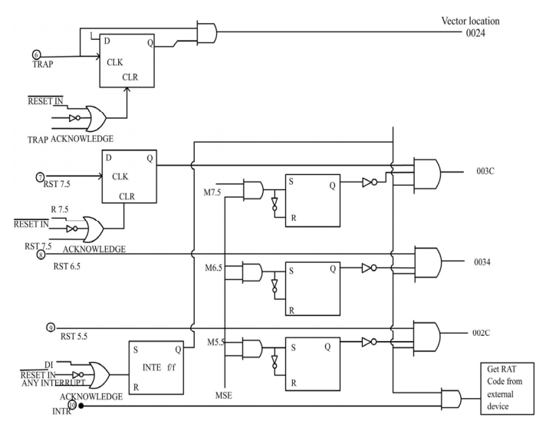
Interrupt
Structure
Of 8085

Slide 2

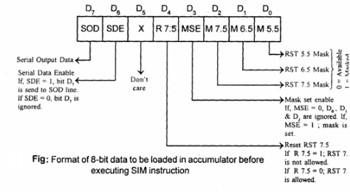
SIM Instruction

Slide 3
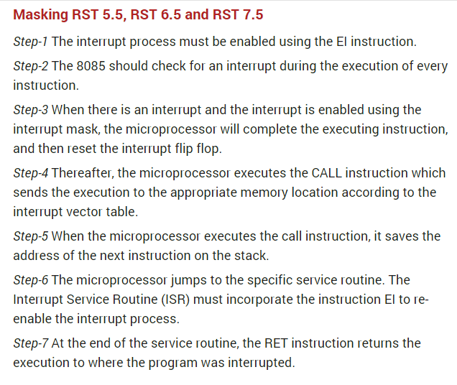
Vectored Interrupts

Slide 4
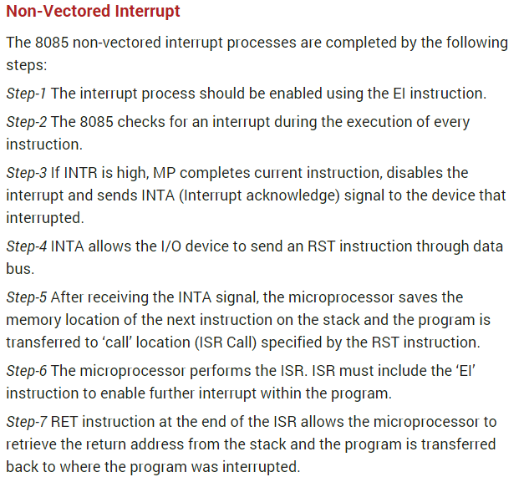

Slide 5
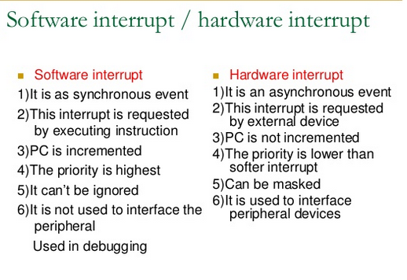

Slide 6
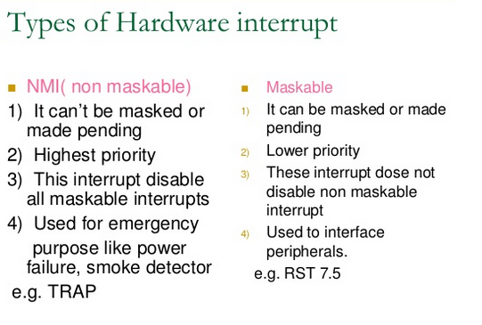

Slide 7
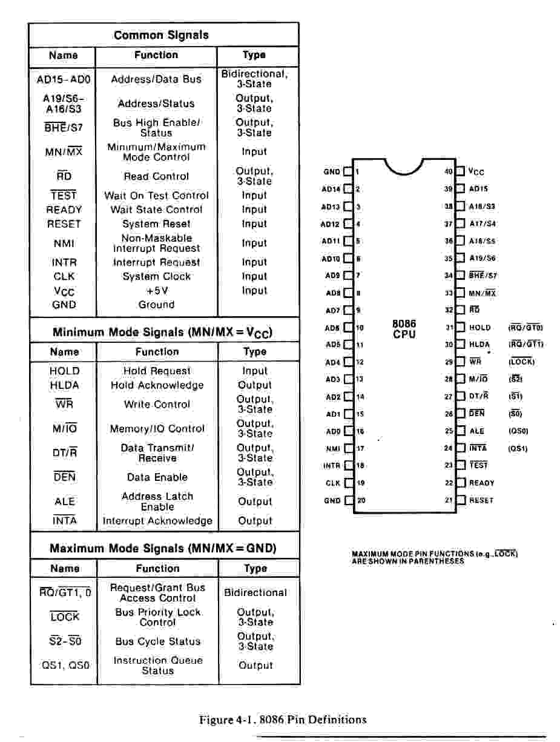
8086 ARCHITECTURE&PIN DIAGRAM

Slide 8
8086 FEATURES
16-bit Arithmetic Logic Unit
16-bit data bus (8088 has 8-bit data bus)
20-bit address bus - 220 = 1,048,576 = 1 meg
The address refers to a byte in memory.
In the 8088, these bytes come in on the 8-bit data bus. In the 8086, bytes at even addresses come in on the low half of the data bus (bits 0-7) and bytes at odd addresses come in on the upper half of the data bus (bits 8-15).
The 8086 can read a 16-bit word at an even address in one operation and at an
odd address in two operations. The 8088 needs two operations in either case.
The least significant byte of a word on an 8086 family microprocessor is at the
lower address.

Slide 9
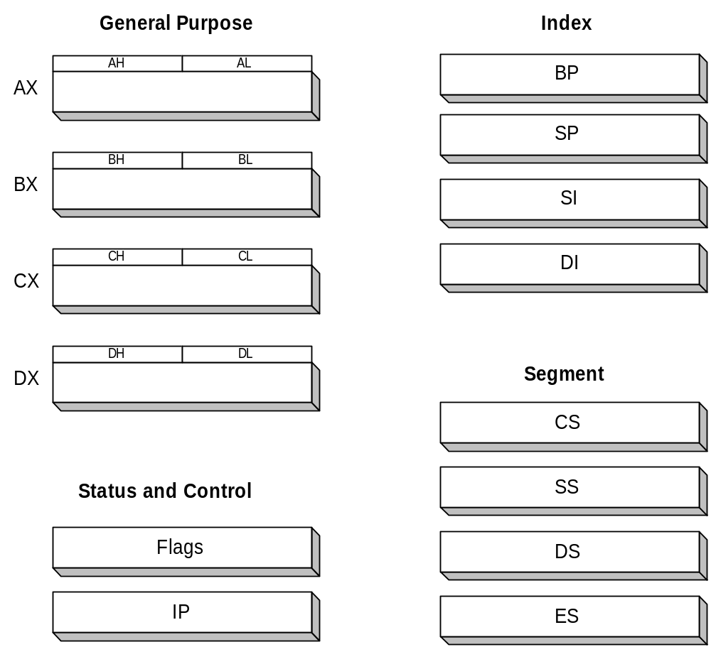
16-bit Registers

Slide 10
8086 ARCHITECTURE
  The 8086 has two parts,
  the Bus Interface Unit (BIU) and
  the Execution Unit (EU).
  The BIU fetches instructions, reads and writes data, and computes the 20-bit address.
  The EU decodes and executes the instructions using the 16-bit ALU.
  The BIU contains the following registers:
    IP - the Instruction Pointer
    CS - the Code Segment Register
    DS - the Data Segment Register
    SS - the Stack Segment Register
    ES - the Extra Segment Register
The BIU fetches instructions using the CS and IP, written CS:IP, to contract
the 20-bit address. Data is fetched using a segment register (usually the DS)
and an effective address (EA) computed by the EU depending on the
addressing mode.

Slide 11
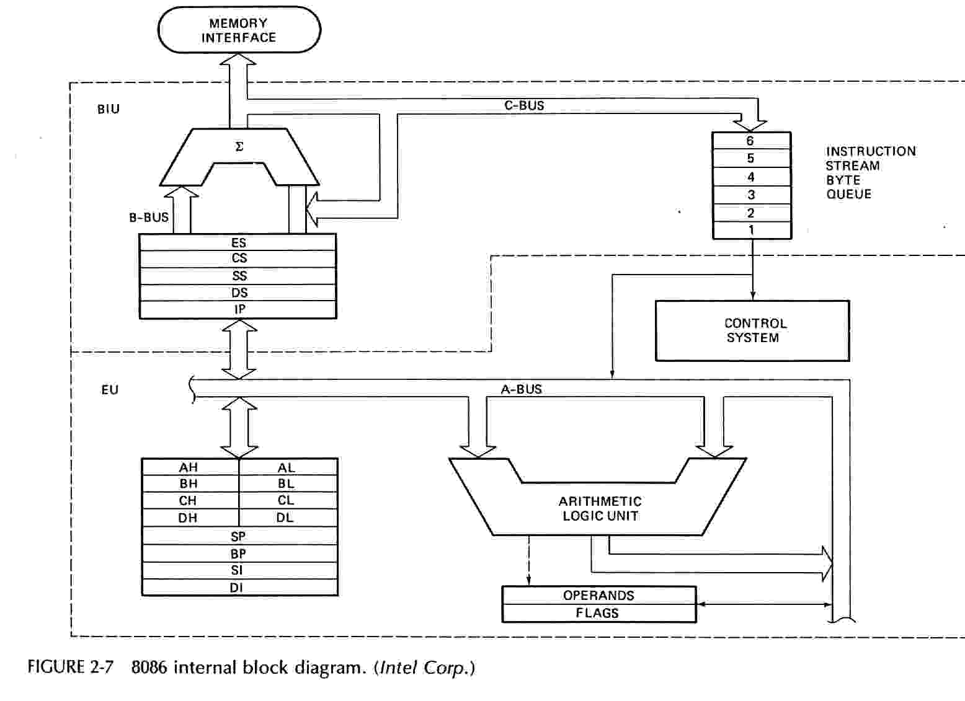
INTERNAL BLOCK

Slide 12
PROGRAM MODEL
8086 Programmer’s Model
ES
Extra Segment
_{BIU registers}
_{(20 bit adder)}
CS
Code Segment
SS
Stack Segment
DS
Data Segment
IP
Instruction Pointer
_{EU registers}
AX
AH
AL
Accumulator
BX
BH
BL
Base Register
CX
CH
CL
Count Register
DX
DH
DL
Data Register
SP
Stack Pointer
BP
Base Pointer
SI
Source Index Register
DI
Destination Index Register
FLAGS

Slide 13
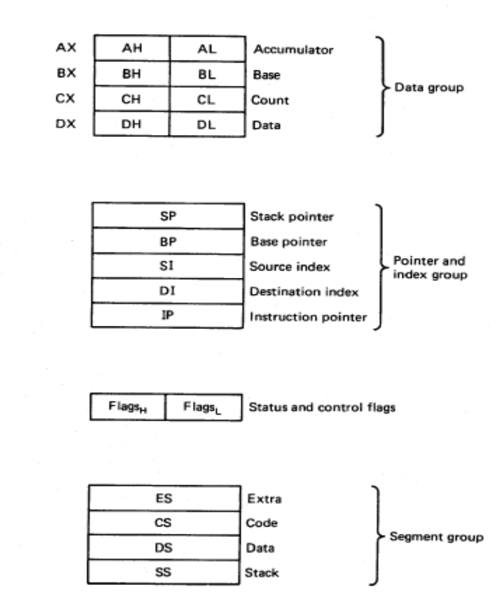
8086/88 internal registers 16 bits (2 bytes each)
AX, BX, CX and DX are two
bytes wide and each byte can
be accessed separately
These registers are used as
memory pointers.
Flags will be discussed later
Segment registers are used
as base address for a segment
in the 1 M byte of memory

Slide 14
The 8086/8088 Microprocessors: Registers
Registers
  Registers are in the CPU and are referred to by specific names
  Data registers
    Hold data for an operation to be performed
    There are 4 data registers (AX, BX, CX, DX)
  Address registers
    Hold the address of an instruction or data element
    Segment registers (CS, DS, ES, SS)
    Pointer registers (SP, BP, IP)
    Index registers (SI, DI)
  Status register
    Keeps the current status of the processor
    On an IBM PC the status register is called the FLAGS register
  In total there are fourteen 16-bit registers in an 8086/8088

Slide 15
Data Registers: AX, BX, CX, DX
Instructions execute faster if the data is in a register
AX, BX, CX, DX are the data registers
Low and High bytes of the data registers can be accessed separately
  AH, BH, CH, DH are the high bytes
  AL, BL, CL, and DL are the low bytes
Data Registers are general purpose registers but they also perform special functions
AX
  Accumulator Register
  Preferred register to use in arithmetic, logic and data transfer instructions because it generates the shortest Machine Language Code
  Must be used in multiplication and division operations
  Must also be used in I/O operations

Slide 16
BX
  Base Register
  Also serves as an address register
  Used in array operations
  Used in Table Lookup operations (XLAT)
CX
  Count register
  Used as a loop counter
  Used in shift and rotate operations
DX
  Data register
  Used in multiplication and division
  Also used in I/O operations

Slide 17
Pointer and Index Registers
Contain the offset addresses of memory locations
Can also be used in arithmetic and other operations
SP: Stack pointer
  Used with SS to access the stack segment
BP: Base Pointer
  Primarily used to access data on the stack
  Can be used to access data in other segments
SI: Source Index register
  is required for some string operations
  When string operations are performed, the SI register points to memory locations in the data segment which is addressed by the DS register. Thus, SI is associated with the DS in string operations.

Slide 18
DI: Destination Index register
  is also required for some string operations.
  When string operations are performed, the DI register points to memory locations in the data segment which is addressed by the ES register. Thus, DI is associated with the ES in string operations.
The SI and the DI registers may also be used to access data stored in arrays

Slide 19
Segment Registers - CS, DS, SS and ES
Are Address registers
Store the memory addresses of instructions and data
Memory Organization
  Each byte in memory has a 20 bit address starting with 0 to 2²⁰-1 or 1 meg of addressable memory
  Addresses are expressed as 5 hex digits from 00000 - FFFFF
  Problem: But 20 bit addresses are TOO BIG to fit in 16 bit registers!
  Solution: Memory Segment
    Block of 64K (65,536) consecutive memory bytes
    A segment number is a 16 bit number
    Segment numbers range from 0000 to FFFF
    Within a segment, a particular memory location is specified with an offset
    An offset also ranges from 0000 to FFFF

Slide 20
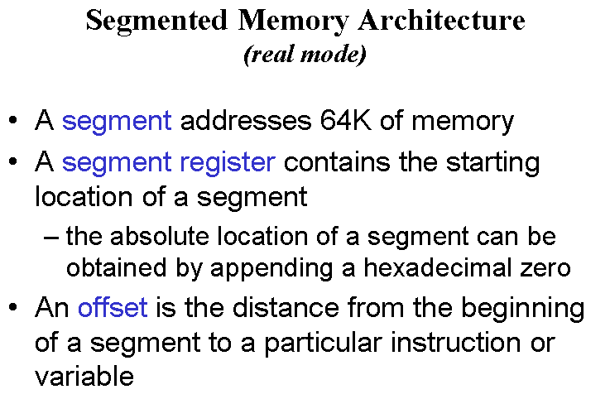

Slide 21

Segmented Memory
Segmented memory addressing: absolute (linear) address is a combination of a 16-bit segment value added to a 16-bit offset
one segment
linear addresses

Slide 22

Intel
Memory Address Generation
The BIU has a dedicated adder for determining physical memory addresses
Offset Value (16 bits)
Segment Register (16 bits)
0 0 0 0
Adder
Physical Address (20 Bits)

Slide 23
Intel
Example Address Calculation
If the data segment starts at location 1000h and a data reference contains the address 29h where is the actual data?
2
9
Offset:
0 0 0 0 0 0 0 0 0 0 1 0 1 0 0 1
Segment:
0 0 0 1 0 0 0 0 0 0 0 0 0 0 0 0
0 0 0 0
Address:
0 0 0 1 0 0 0 0 0 0 0 0 0 0 1 0
1 0 0 1

Slide 24
SEGMENT:OFFSET ADDRESS
Logical Address is specified as segment:offset
Physical address is obtained by shifting the segment address 4 bits to the left and adding the offset address
Thus the physical address of the logical address A4FB:4872 is
      A4FB0
      + 4872
      A9822

Slide 25
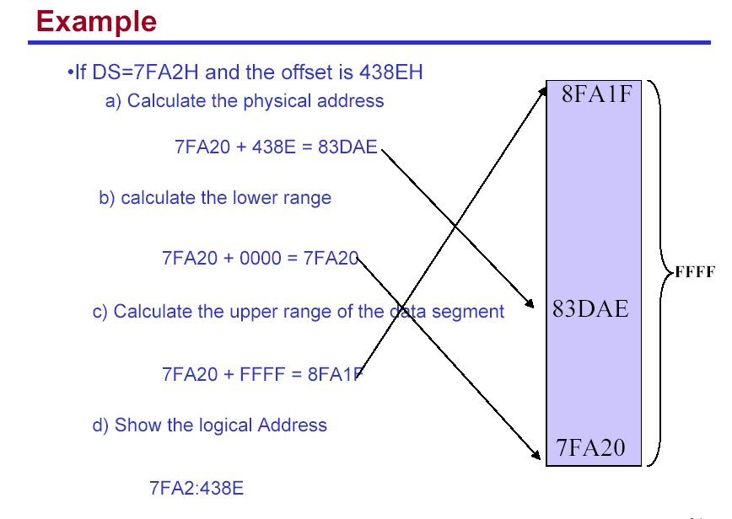
EXAMPLE

Slide 26
THE CODE SEGMENT
_{0H}
CS:
0400H
4000H
CS:IP = 400:56
Logical Address
IP
0056H
4056H
Segment Register
Offset
Physical or
Absolute Address
Memory
0400
0
+
0056
_{0FFFFFH}
04056H
The offset is the distance in bytes from the start of the segment.
The offset is given by the IP for the Code Segment.
Instructions are always fetched with using the CS register.
The physical address is also called the absolute address.

Slide 27
THE DATA SEGMENT
_{0H}
05C00H
DS:
05C0
05C50H
EA
0050
DS:EA
Memory
05C0
0
Segment Register
Offset
Physical Address
+
0050
_{0FFFFFH}
05C50H
Data is usually fetched with respect to the DS register.
The effective address (EA) is the offset.
The EA depends on the addressing mode.

Slide 28
THE STACK SEGMENT
_{0H}
SS:
0A00
0A000H
0A100H
SP
0100
SS:SP
Segment Register
Offset
Physical Address
Memory
0A00
0
+
0100
0A100H
_{0FFFFFH}
The offset is given by the SP register.
The stack is always referenced with respect to the stack segment register.
The stack grows toward decreasing memory locations.
The SP points to the last or top item on the stack.
PUSH - pre-decrement the SP
POP - post-increment the SP

Slide 29
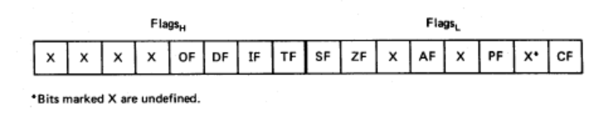
Flags
Carry flag
Overflow
Direction
Parity flag
Interrupt enable
Auxiliary flag
Trap
Zero
Sign
6 are status flags
3 are control flag

Slide 30
Flag Register
Conditional flags:
  They are set according to some results of arithmetic operation. You do not need to alter the value yourself.
Control flags:
  Used to control some operations of the MPU. These flags are to be set by you in order to achieve some specific purposes.
Flag |  |  |  |  | O | D | I | T | S | Z |  | A |  | P |  | C
Bit no. | 15 | 14 | 13 | 12 | 11 | 10 | 9 | 8 | 7 | 6 | 5 | 4 | 3 | 2 | 1 | 0
CF (carry) Contains carry from leftmost bit following arithmetic, also contains last bit from a shift or rotate operation.

Slide 31
Flag Register
OF (overflow) Indicates overflow of the leftmost bit during arithmetic.
DF (direction) Indicates left or right for moving or comparing string data.
IF (interrupt) Indicates whether external interrupts are being processed or ignored.
TF (trap) Permits operation of the processor in single step mode.

Slide 32
SF (sign) Contains the resulting sign of an arithmetic operation (1=negative)
ZF (zero) Indicates when the result of arithmetic or a comparison is zero. (1=yes)
AF (auxiliary carry) Contains carry out of bit 3 into bit 4 for specialized arithmetic.
PF (parity) Indicates the number of 1 bits that result from an operation.

Slide 33
Addressing Modes
Immediate addressing.
Register addressing.
Direct addressing.
Indirect addressing
Implied addressing.
Indexed addressing
Relative addressing

Slide 34
Interrupts &Interrupt Service Routine
An interrupt signals the processor to suspend its current activity
(i.e. running your program) and to pass control to an interrupt service program (i.e. part of the operating system).
A software interrupt is one generated by a program (as opposed to
one generated by hardware).
The 8086 int instruction generates a software interrupt.
It uses a single operand which is a number indicating which MSDOS
subprogram is to be invoked.
This subprogram handles a variety of I/O operations by calling
appropriate subprograms.

Slide 35
MAXIMUM MODE
Maximum mode
Maximum mode is designed to be used with a coprocessor exists in the system.
All the control signals (except RD) are not generated by the microprocessor.
But we still need those control signals.
Solution:
8288.

Slide 36
8086 maximum & minimum modes
8086 maximum & minimum modes
The mode is controlled by MN/MX.
Maximum mode is obtained by connecting MN/MX to low and minimum mode is by connecting it to high.
Having two different modes (minimum and maximum) is used only 8088/8086.
Each mode enables a different control structure.
Minimum mode operation and control signals are very similar to those of 8085.
So 8085 8-bit peripherals can be used with 8086 without special considerations.
Easy and least expensive way to build single processor systems

Slide 37
Microcontroller
A smaller computer
On-chip RAM, ROM, I/O ports...
Example：Motorola’s 6811, Intel’s 8051, Zilog’s Z8 and PIC 16X
CPU
RAM
ROM
A single chip
Serial COM Port
I/O Port
Timer
Microcontroller

Slide 38
Microprocessor vs. Microcontroller
Microprocessor
CPU is stand-alone, RAM, ROM, I/O, timer are separate
designer can decide on the amount of ROM, RAM and I/O ports.
expansive
versatility
general-purpose
Microcontroller
CPU, RAM, ROM, I/O and timer are all on a single chip
fix amount of on-chip ROM, RAM, I/O ports
for applications in which cost, power and space are critical
single-purpose
Notes:
versatility 多用途的: any number of applications for PC

Slide 39
Block Diagram
External interrupts
On-chip ROM for program code
Timer/Counter
Interrupt Control
On-chip RAM
Timer 1
Counter Inputs
Timer 0
CPU
Bus Control
Serial Port
4 I/O Ports
OSC
P0 P1 P2 P3
TxD RxD
Address/Data

Slide 40
Pin Description of the 8051
P1.0
1
40
Vcc
P1.1
2
39
P0.0(AD0)
P1.2
3
38
P0.1(AD1)
P1.3
4
8051
(8031)
37
P0.2(AD2)
P1.4
5
36
P0.3(AD3)
P1.5
6
35
P0.4(AD4)
P1.6
7
34
P0.5(AD5)
P1.7
8
33
P0.6(AD6)
RST
9
32
P0.7(AD7)
(RXD)P3.0
10
31
EA/VPP
(TXD)P3.1
11
30
ALE/PROG
(INT0)P3.2
12
29
PSEN
(INT1)P3.3
13
28
P2.7(A15)
(T0)P3.4
14
27
P2.6(A14)
(T1)P3.5
15
26
P2.5(A13)
(WR)P3.6
16
25
P2.4(A12)
(RD)P3.7
17
24
P2.3(A11)
XTAL2
18
23
P2.2(A10)
XTAL1
19
22
P2.1(A9)
GND
20
21
P2.0(A8)

